Slide 1
How to fill out a Municipal Tonnage Report and Accompanying forms
A quick visual guide
Erin Jensen, Environmental Specialist, NJDEP

Slide 2
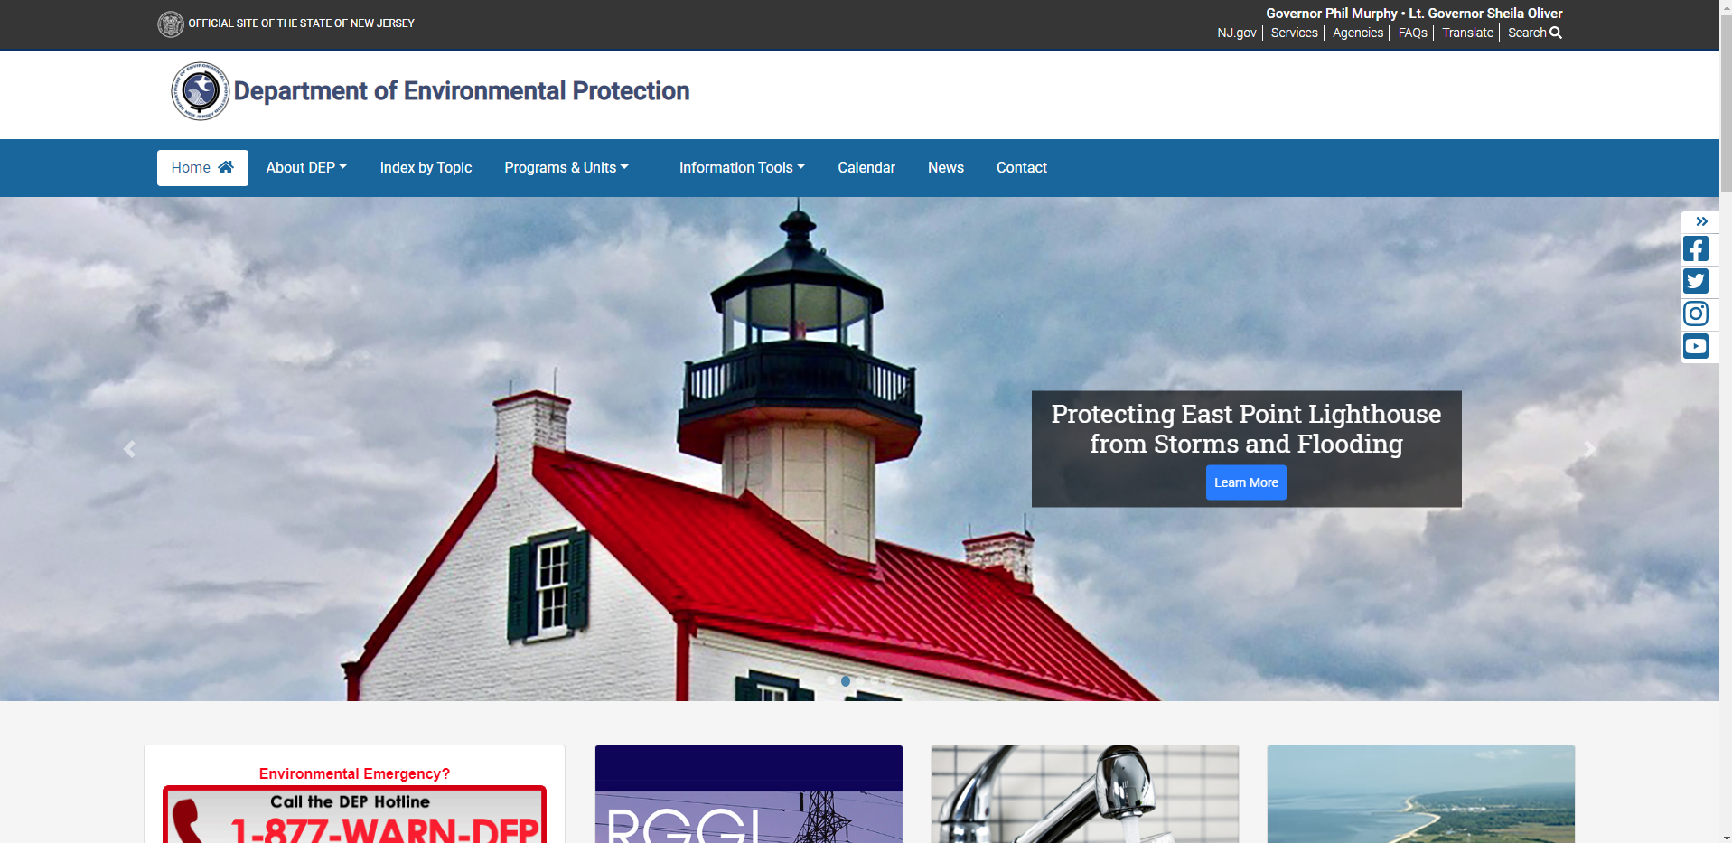
To download a new copy of the Recycling Tonnage Report’s Excel file, start by going to http://www.nj.gov/dep/
Click on Programs & Units

Slide 3
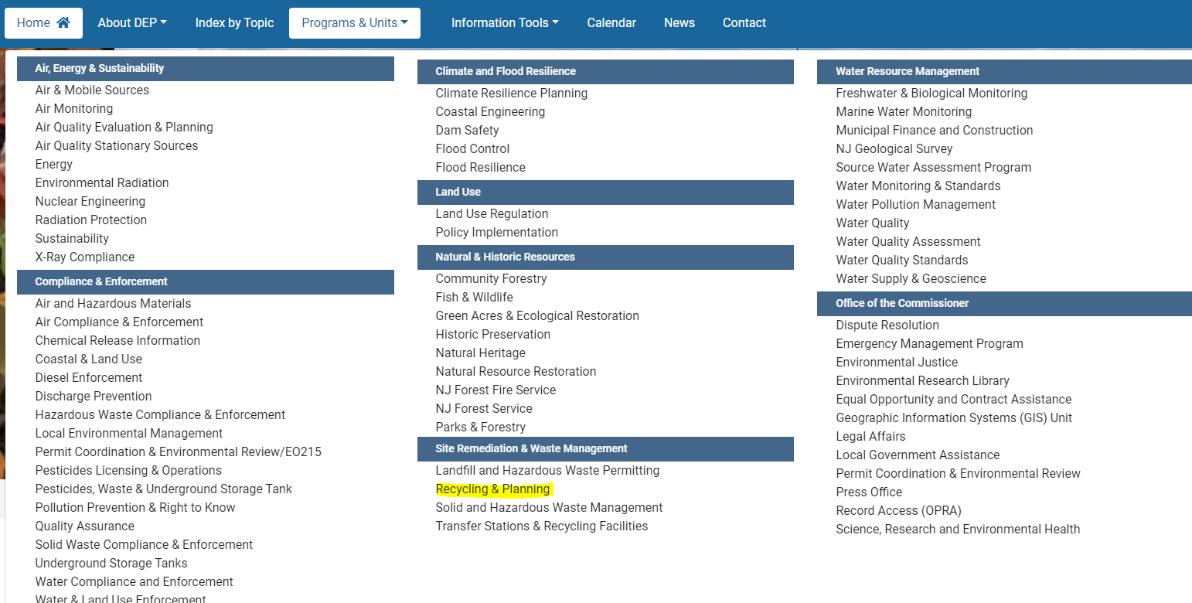
Then go to Recycling & Planning

Slide 4
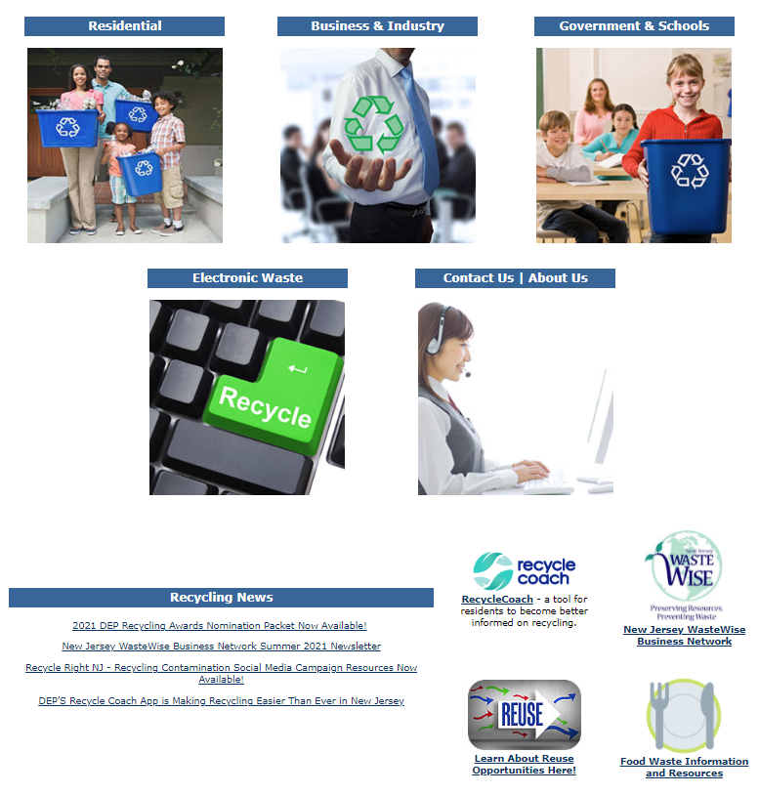
Then, click on Government & Schools
Recycling Education

Slide 5
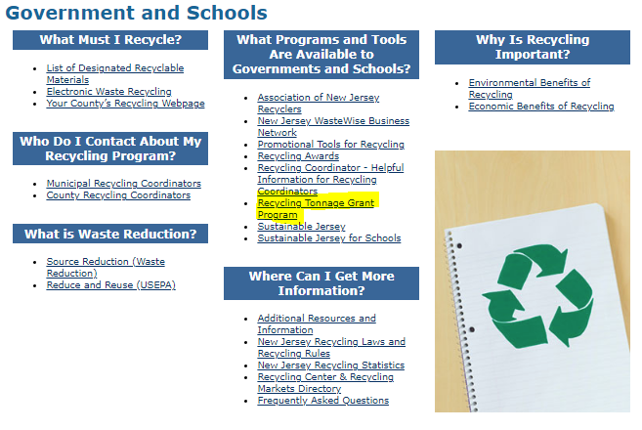
Click on “Recycling Tonnage Grant Program”

Slide 6
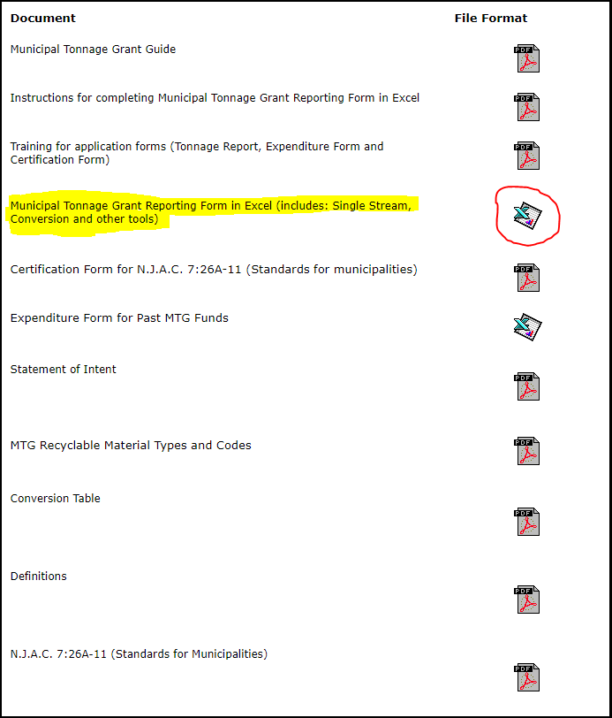
Municipal Recycling Tonnage Report’s Excel file is found here.
Click here to download

Slide 7
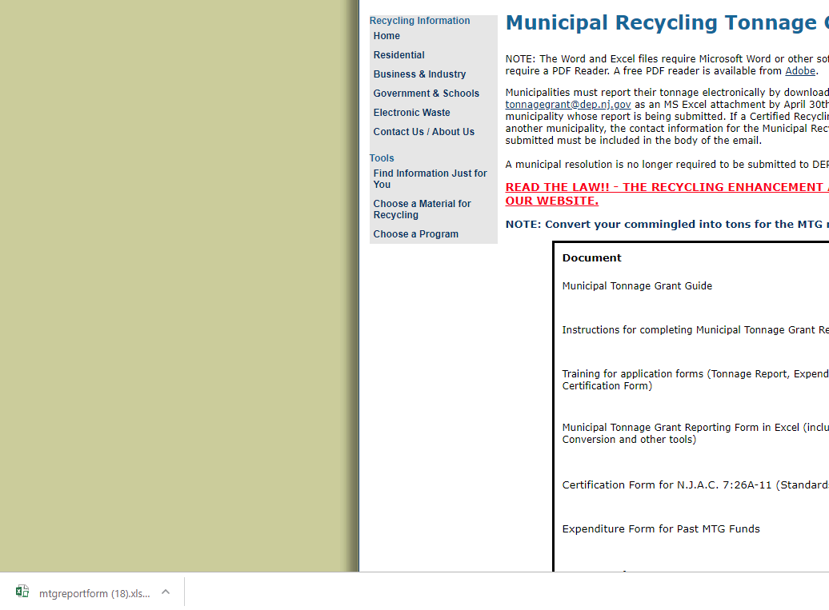
Click on the Excel file once downloading is complete
This will open the Excel document

Slide 8
First Step is to Enable the Document
This will allow the spreadsheet to function properly.
You will not be able to save the document without this step.
Depending on your version of Excel you have on your computer, you may see either of these at the top of your Excel document
Click either Enable Editing or Enable Content depending on what you see.
If you clicked Enable Content you are done.
If you clicked Enable Editing you will now have the ability to Click Enable Content.

Slide 9
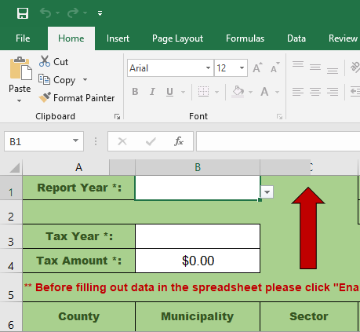
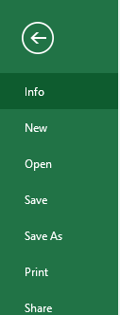
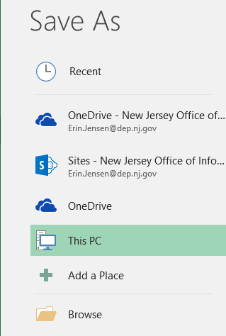
To save the document Click here and select “Save As”
Choose where you want to save your file by clicking “Browse”
Save as:
(Municipality Name) 2021

Slide 10
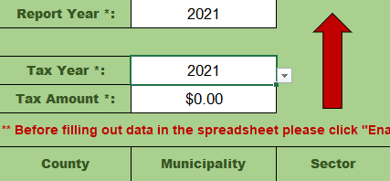
Next, fill out the year that the tonnage you are submitting was generated
Then, fill in your REA tax information for the same year
The REA tax is the $3/ton tax paid on all SW disposed of in NJ
REA tax information can be found with your CFO or whomever tracks SW disposed for your Municipality.
It can also be calculated by:
SW disposed (tons) x $3 = REA tax paid

Slide 11
Here is where you fill out who is filling in the data and who is certifying and submitting the report.
If the MRC filling out the report is a CRC, both fields should say the same name.
If the municipality has an agreement with another town or their county to submit the report on their behalf, the “Certified By” field should have the name of the CRC reviewing and submitting the report.
The CRC signing the report must be the person who submits the application

Slide 12
Once those fields are complete, it is time to insert your data.
Each generator and each material type should be entered in its own row.
For example, if one generator generates 4 different types of recycled material, each material type should be entered on its own row.
This also applies to each type of End Market. If one generator generates a material and it is sent to 2 different End Markets, each End Market gets its’ own line
Rows may be left blank, however, please make sure if you are skipping a line, to delete all information in that line

Slide 13
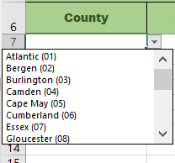
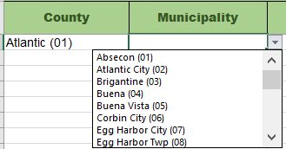
First, use the drop-down menu under the County column to choose the County.
Once you make your selection, this field can be copied and pasted into any of the rows below. Please make sure there is a County selection for all the rows you enter data into.
Next, follow the same instruction to fill in the Municipality. The Municipality field will be populated with the municipalities in the County you selected in the previous step.
*Note: All fields can be copy and pasted to as many rows as needed

Slide 14
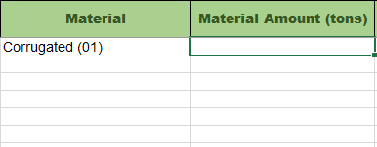
Next, fill in the Sector field.
The options include Residential, Commercial, Institutional and Industrial (factory).
Note: Industrial recycling does not qualify for MTG funding, however, is counted toward the overall recycling rate
Then fill in the Material field (the drop down will include all 30 material types)…
…and the Material Amount in tons.
Please double check that all of your Material Amount is submitted in tons

Slide 15
Industrial vs. Commercial
Industrial – pre-consumer
Paper scrap from creating newspapers/magazines
Food scraps from packaging facilities
Left over packaging after design change
Commercial – post-consumer
Recyclables generated in cafeterias
Paper recycled from offices
Recycling collected from restaurants (front and back end)

Slide 16
Once those first 5 fields are filled in, enter the rest of the requested information.
Once you enter the Material amount, the remaining required columns will turn red. This is a reminder to not forget these fields. Please fill these fields out to the best of your ability.
Continue to follow these steps until all of your data is entered.
The remaining tabs along the bottom are the same as in previous spreadsheets

Slide 17
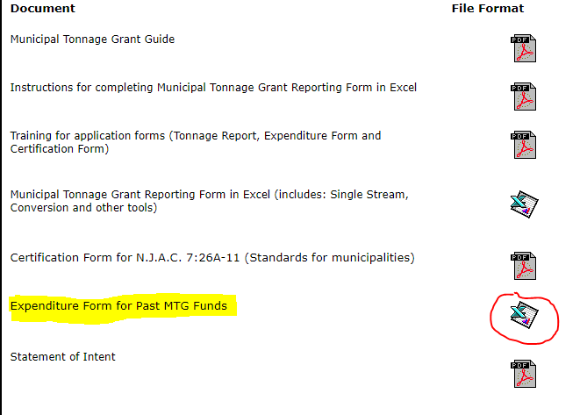
Next step is to fill out the Expenditure Report for MTG funds from previous years.
The Excel file can be found in the same place as the Tonnage Report.

Slide 18
You will need to Enable Content and/or Enable Editing again
Save the same way as the Tonnage Report.
Name as (Municipality Name) 2021 Expenditures
First Step is to Enter in the total Grant amount your town was awarded for the listed grant year
Then enter your County and Municipality information
Grant year is the name of the grant, not the year you received the grant funds. I.e., you received the 2018 grants funds at the end of 2020
This information can be found at http://www.nj.gov/dep/dshw/recycling/stats.htm
The totals are listed by year under Recycling Tonnage Grant Payout Schedule

Slide 19
Then, fill in all the ways you spent MTG funds during calendar year 2021.
Please note: this is a change from previous years when we asked how money from a specific grant check was spent
Save your finished form

Slide 20
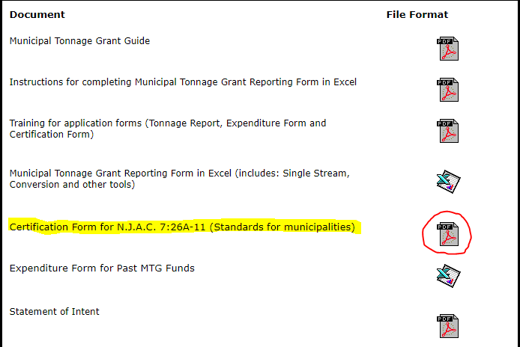
Next step is to Download the Certification Form.
The PDF file can be found in the same place as the Tonnage Report.
Click on the PDF icon to open the PDF as a web document

Slide 21
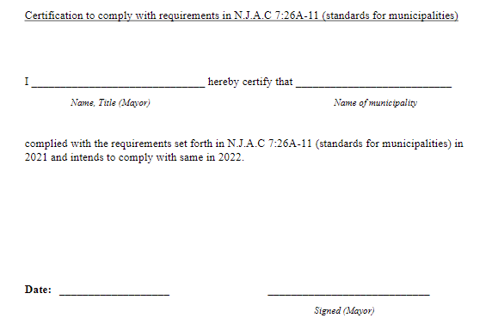
Print the document
Sign the form, scan it into your computer and save as a PDF
The form must be signed by the Mayor (or equivalent, if you do not have a Mayor title) of the Municipality
Save your finished form
Name as (Municipality Name) 2021 Certification

Slide 22
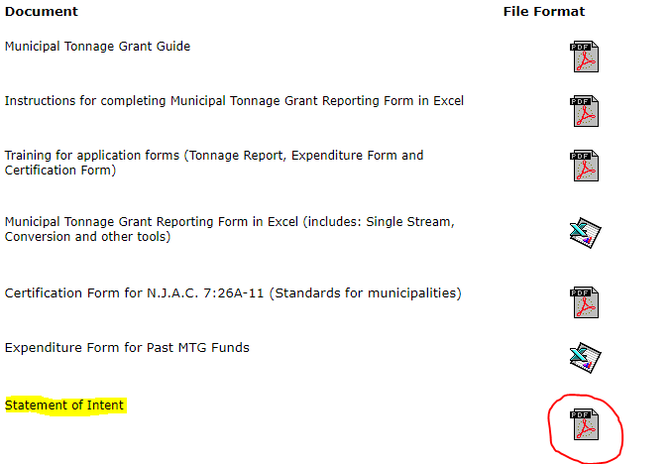
Last step is to Download the Statement of Compliance/Intent Form.
The PDF file can be found in the same place as the Tonnage Report.
Click on the PDF icon to open the PDF as a web document

Slide 23
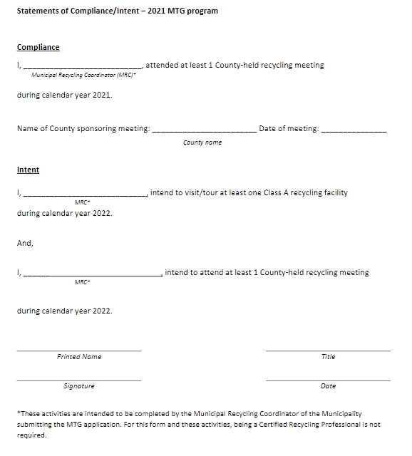
Print the document
Sign the form, scan it into your computer and save as a PDF
The form should be filled out and signed by the MRC (CRP certification not required)
Save your finished form
Name as (Municipality Name) 2021 Statement of Compliance/Intent

Slide 24
All final documents should be attached to an email
The Tonnage Report and Expenditure Report should be attached as an Excel file.
The Certification and Statement of Compliance/Intent forms should be attached as individual PDFs.
Below instructions are for Outlook 365. Steps may vary by email provider.
Open a new message and click on “Attach File”
Choose your Tonnage Report, Expenditure report, Certification form and Statement of Compliance/Intent form one at a time
Files can also be dragged and dropped into the message field

Slide 25
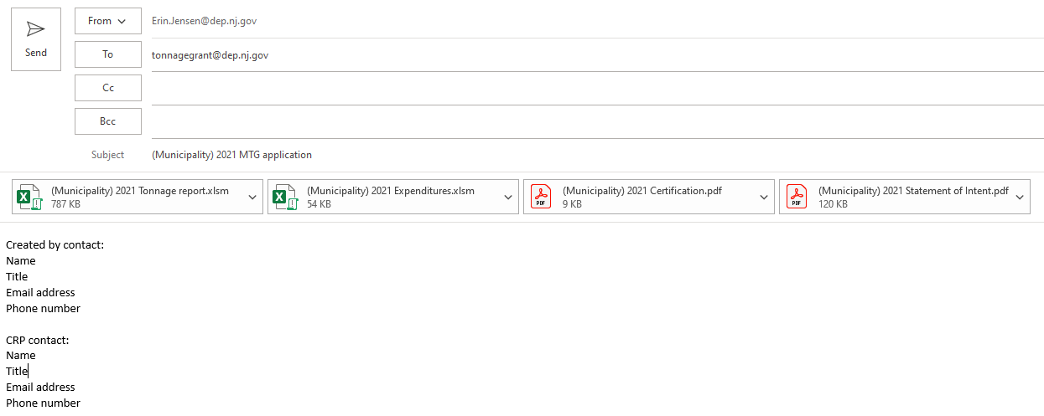
Send the email to TonnageGrant@dep.nj.gov
Please include the name of the reporting Municipality in the email subject line
This is where you will also note what your “Other Materials” are and any notes on large deviations from previous years tonnages
Include the contact information (name, title, email and phone number) for the person who created the Tonnage Report and the CRC signing the report in the body of the email.

Slide 26
Applications are due no later than April 30, 2022
If applications are submitted in full by April 30, then the Tonnage Report may be resubmitted to the Department by June 15, 2022

Slide 27
You will receive a Thank You email once your complete application
has been received and initially reviewed
If you have any additional question, please feel free to email Erin Jensen at TonnageGrant@dep.nj.gov or call at (609)984-4250

